Slide 1
Analysing Algorithms

Slide 2
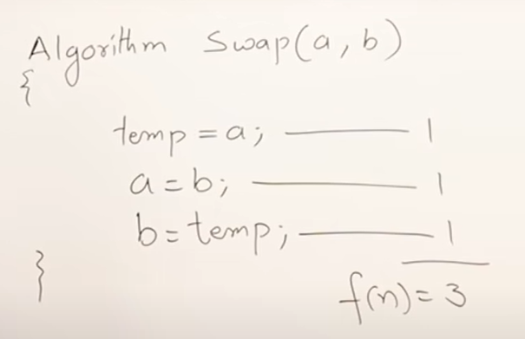
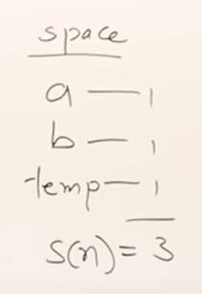
Analyzing an Algorithm
We say that a simple operation or an expression takes 1 unit of time.
So here, in this function three such simple operations are there.
So it will take 3 units of time.
O(1) for constant
Time or space.
X = 5*a + 6*b //this expression will take 1 unit of time.

Slide 3
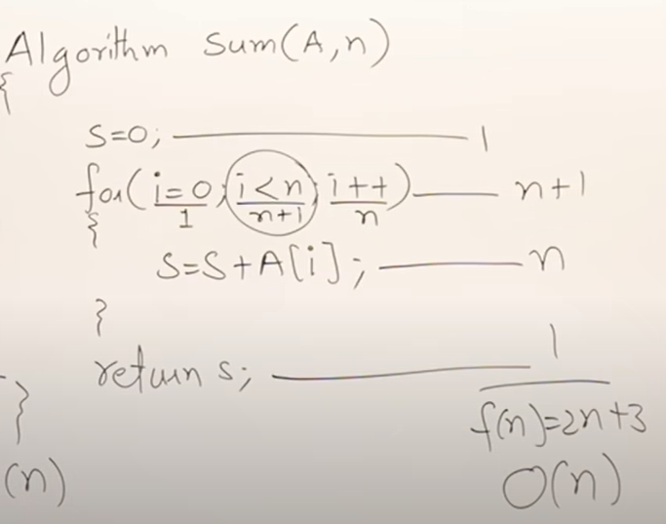
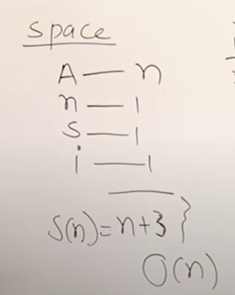
Analysing an Algorithm

Slide 4
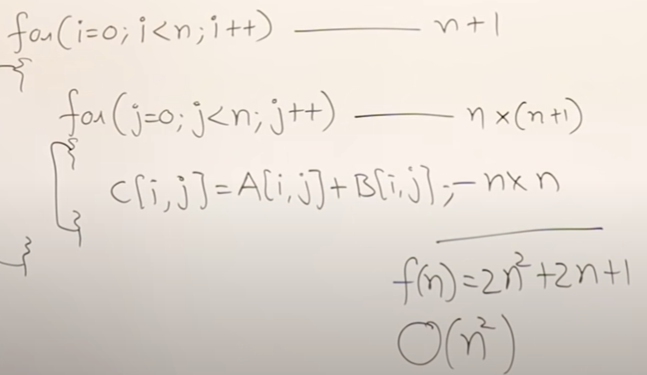
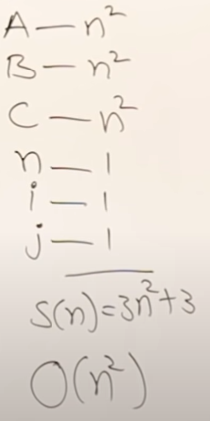
Analysing an Algorithm

Slide 5
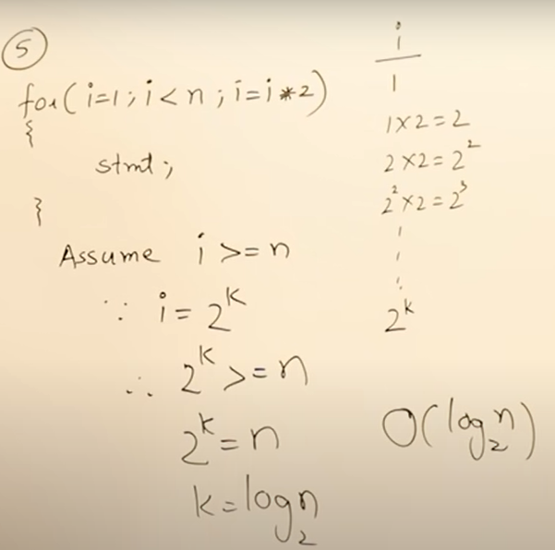
Analysing an Algorithm
Logarithmic Time
Complexity

Slide 6
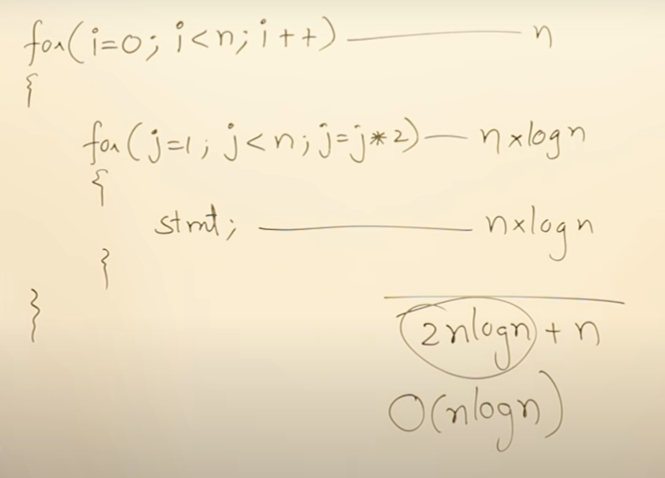
Analysing an Algorithm
O(nlogn) time complexity

Slide 7
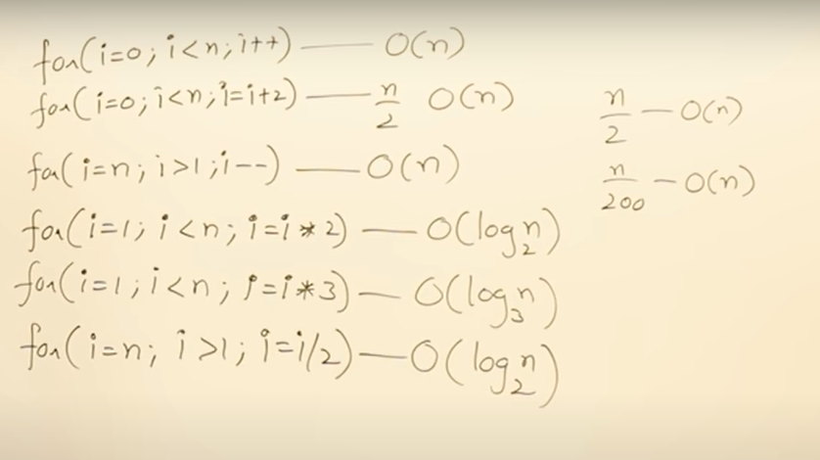
Analysing an Algorithm

Slide 8
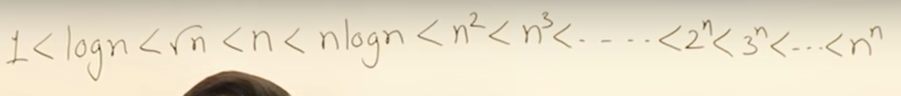
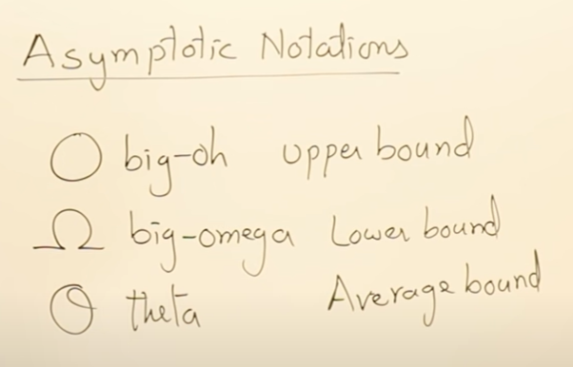
Analysing an Algorithm

Slide 9
Analysing an Algorithm
For f(n) = 2n+3
f(n) = Ω(n), f(n) = Ω(logn) f(n) = O(n), f(n) = O(n²)
f(n) = O(2^{n})
f(n) = 𝚹(n)
Lower bound
Average bound
Upper bound

Slide 10
Analysing an Algorithm
Best Case Scenario
Average Case Scenario
Worst Case Scenario
E.g. for a linear search
B(n) = O(1)
W(n) = O(n)
A(n) = (n+1)/2
B(n) = 1
B(n) = O(1)
B(n) = Ω(1)
B(n) = 𝚹(1)
Similarly, all the cases can be represented by any representation.
For average case:
Complexity = all possible case time
Total cases
Average time = 1+2+3+4+...+n
n
= n(n+1)/2 = (n+1)/2
n

